Slide 1
In this segment
Integration Styles
Introduction - Application Integration Criteria
Application Integration Options
File Transfer
Shared Database
Remote Procedure Invocation
Messaging

Slide 2
Integration Styles
Introduction – Application Integration Criteria
Enterprise integration is the task of making (possibly heterogenous) applications work together to produce a unified set of functionality.
Integration Criteria
Application integration –need to reuse, interact and integrate other applications
Application coupling – Minimum dependency /
Integration simplicity – Minimize customization needed to integrate applications
Integration technology – Reduce the need for specialized hardware/software for integration
Data format – Agreement on data format / translation
Data timeliness – Reduce staleness of data due to integration nuances
Data or functionality – Ability to share both data and functionality
Asynchronicity – Ability to proceed without being blocked for complex batch transactions

Slide 3
Integration Styles
Application Integration Options
No one fit for all methodology – option chosen depends on context
Major integration options:
File Transfer – applications communicate via files
Shared Database – applications share common data using shared database
Remote Procedure Invocation – Applications expose procedures to be invoked by integrating applications
Messaging – applications connect/communicate via common messaging system

Slide 4
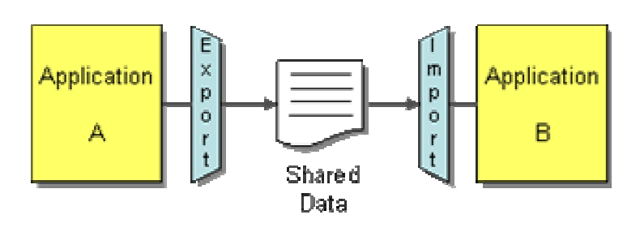
Integration Styles
File Transfer
Each application produces files with data that it needs to share with others
Integrators (middleware) handle transforming files into various formats and access aspects
Legacy file formats (Mainframe)
Text format (Unix variants)
CSV format (Windows based systems)
XML/JSON formats (Web based systems)
Files are produced/consumed at a frequency demanded by business
Hourly, Nightly, Weekly etc.
Ex: Batch processing applications like medical insurance claims (nightly)
Less work on integration side, more work for application developers
Staleness of data, in the generation of real time processing

Slide 5
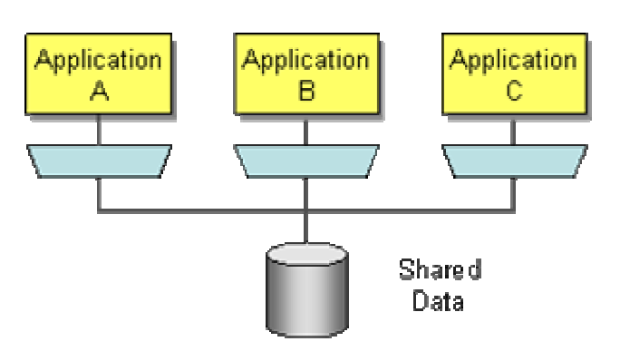
Integration Styles
Shared Database
Integrate applications by having them store their data in a single Shared Database
Consistency in data format and ease of access
Challenges
Deciding on a unified schema that fits all applications’ needs
External packages that do not conform to enterprise schema
Performance bottlenecks on database
Distributed database locking / deadlock issues

Slide 6
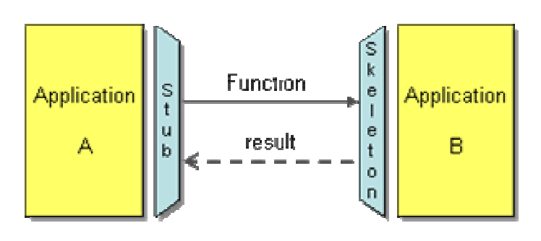
Integration Styles
Remote Procedure Invocation
Applies the principle of encapsulation to integrating applications
Applications provide interface for the methods/data they want to expose to other applications to integrate with
Each application maintains its own encapsulation/integrity of data
Promotes certain degree of (tight) coupling between applications
Examples: CORBA, COM, .NET Remoting etc.

Slide 7
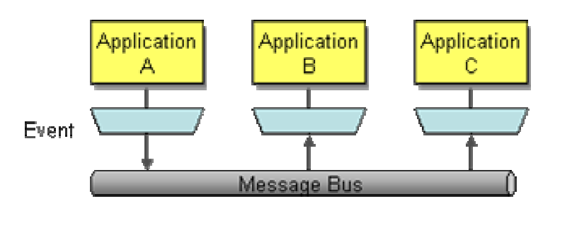
Integration Styles
Messaging
Transfers packets of data frequently, immediately, reliably, and asynchronously, using customizable formats
Supports asynchronous communication seamlessly
Allows loose coupling of applications
Supports behavioral collaboration of applications with event based communication

